Slide 1
Azure Static Web App

Slide 2






Chi Sono
Marco Milani
Microsoft Certified Solution Developer
Microsoft Specialist
Microsoft Certified Professional
Xamarin Certified Mobile Developer
Architect @ Sinergest srl
https://github.com/markjackmilian​

Slide 3
Agenda
What is a Static Web App
The old ways
Azure Static Web App
Azure Functions
Hands On
Deploy - Oryx
Configuration

Slide 4
What is a Static Web App
1
Static web apps are commonly built using libraries and frameworks like Angular, React, Svelte, Vue, or Blazor where server side rendering is not required

Slide 5
App Content
HTML
CSS
JavaScript
Image assets
With a traditional web server, these assets are served from a single server alongside any required API endpoints.

Slide 6
Before Static Web App
2
What solutions did Azure offer before the existence of the "Static Web App" service?

Slide 7
Old ways
Web App
Expensive
Full web server hosting
Not globally distribuited by default
Hosting in Azure Storage
No headers configuration
AuthN and AuthZ are not supported
HTTPS with Azure CDN

Slide 8
Azure Static Web App
3
What does the Azure Static Web App service offer?

Slide 9
Key features
Web hosting for static content like HTML, CSS, JavaScript, and images.
Integrated API support provided by Azure Functions with the option to link an existing Azure Functions app using a standard account.
First-class GitHub and Azure DevOps integration where repository changes trigger builds and deployments.

Slide 10
Key features
Globally distributed static content, putting content closer to your users.
Free SSL certificates, which are automatically renewed.
Custom domains to provide branded customizations to your app.
Generated staging versions powered by pull requests enabling preview versions of your site before publishing.

Slide 11
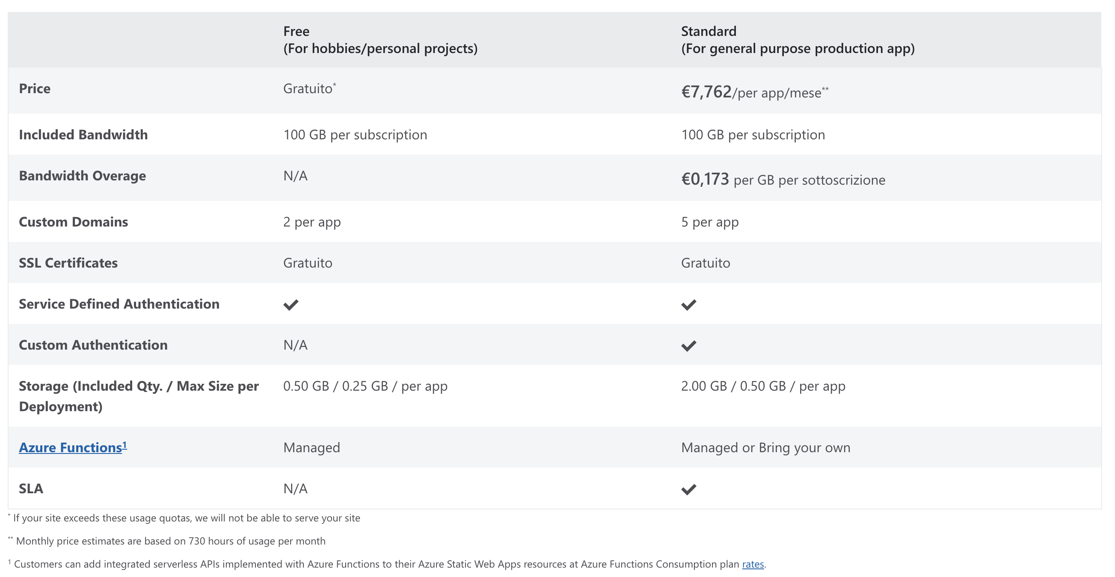
Pricing

Slide 12
It's a serverless world
SERVER
SERVERLESS :)
LESS

Slide 13
Serverless computing is a cloud computing execution model in which the cloud provider allocates machine resources on demand, taking care of the servers on behalf of their customers.

Slide 14
Serverless developer does not have to deal with
Capacity planning
Configuration
Management
Maintenance
Fault tolerance
Scaling
VMs or physical servers.

Slide 15
Azure Functions
Azure Functions is a cloud service available on-demand that provides all the continually updated infrastructure and resources needed to run your applications.
You focus on the pieces of code that matter most to you, and Functions handles the rest. Functions provides serverless compute for Azure.
You can use Functions to build web APIs, respond to database changes, process IoT streams, manage message queues, and more.

Slide 16
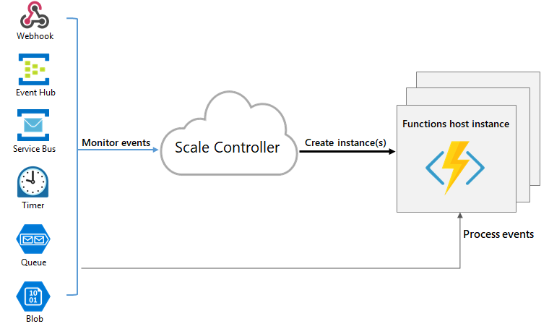
Azure Functions

Slide 17
Azure Static Web Apps provides serverless API endpoints via Azure Functions. By using Azure Functions, APIs dynamically scale based on demand, and include the following features:
Integrated security with direct access to user authentication and role-based authorization data.
Seamless routing that makes the api route available to the web app securely without requiring custom CORS rules.
You can use Functions to build web APIs, respond to database changes, process IoT streams, manage message queues, and more.

Slide 18
Local SWA Environment
4
How simulate local Static Web App cloud environment locally?

Slide 19
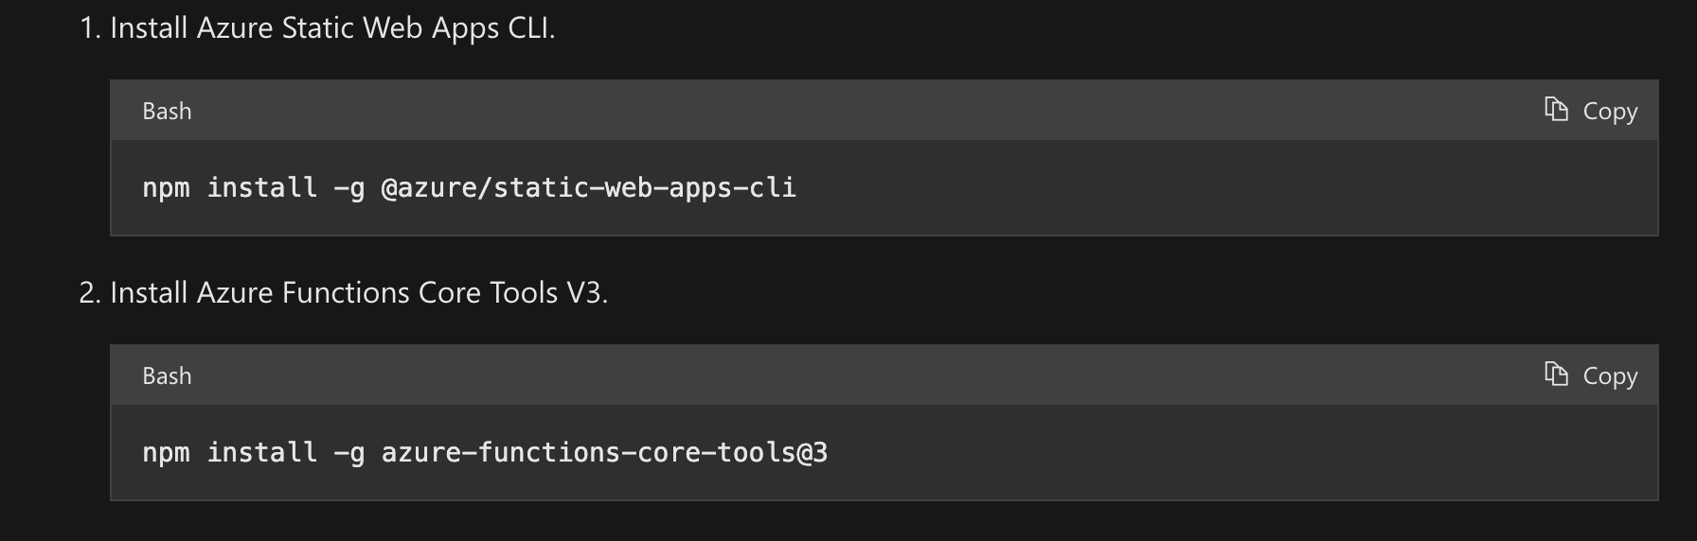
Azure Static Web Apps CLI
NB Use azure-function-core-tools@4

Slide 20
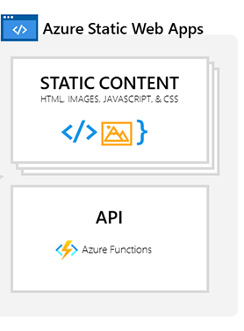
Azure Static Web Apps CLI
swa start https://localhost:5001 --run "dotnet run --project Client/Client.csproj" --api-location Api

Slide 21
Hands on
6

Slide 22
Deploy
7
Auto generated workflow with Oryx

Slide 23
Oryx
microsoft/Oryx: Build your repo automatically. (github.com)
Oryx is a build system which automatically compiles source code repos into runnable artifacts. It is used to build web apps for Azure App Service and other platforms.
Oryx generates and runs an opinionated build script within a build container based on analysis of a codebase's contents.
For example, if package.json is discovered in the repo Oryx includes npm run build in the build script; or if requirements.txt is found it includes pip install -r requirements.txt.
Supported platform: Oryx/supportedPlatformVerions.md at main · microsoft/Oryx (github.com)

Slide 24
Staticwebapp config
8
Usage of staticwebapp.config.json

Slide 25
Configuration
Configure Azure Static Web Apps | Microsoft Docs
routes.json that was previously used to configure routing is deprecated. Use staticwebapp.config.json as described in this article to configure routing and other settings for your static web app.
Routing and Fallback rules
Authentication and Authorization
HTTP response overrides
Global HTTP header definitions
Custom MIME types
Networking
Example: Configure Azure Static Web Apps | Microsoft Docs

Slide 26
Thanks!
Any questions?
You can find me at:
@markjackmilian on GitHub
emme.milani@hotmail.it

